Slide 1
Deep learning for person re-identification
Jingya Wang

Slide 2
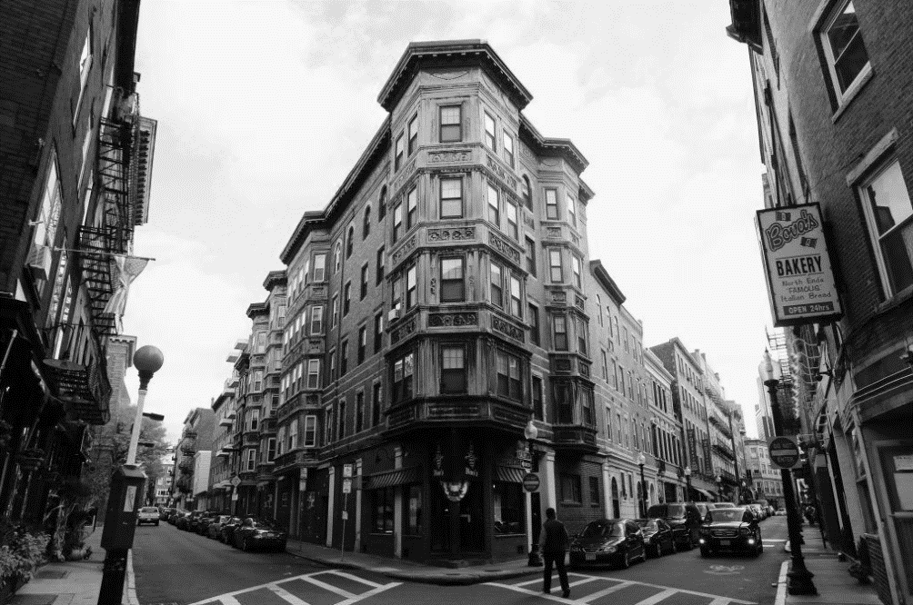
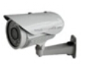
Person re-identification (re-id)

Slide 3
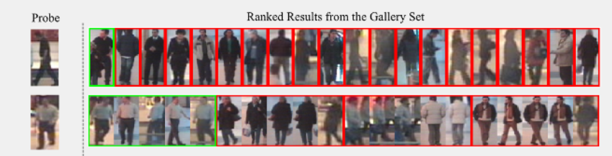
Person re-identification (re-id) aims at matching people across non-overlapping camera views distributed at distinct locations.
Camera A
Camera B

Slide 4
Presentation Outline
Supervised Person Re-Identification
Unsupervised Person Re-Identification
Active Learning for Person Re-Identification
Occluded Person Person Re-Identification

Slide 5
Supervised Person Re-Identification
Training and testing data are from same domain
Classification loss
Contrastive loss
Triplet loss
Lavi, B., Serj, M.F. and Ullah, I., 2018. Survey on deep learning techniques for person re-identification task
Reading material:
https://zhuanlan.zhihu.com/p/103278453

Slide 6
https://paperswithcode.com/sota/person-re-identification-on-market-1501

Slide 9
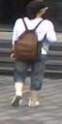
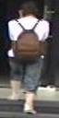
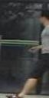
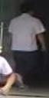
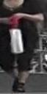
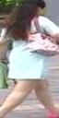
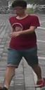
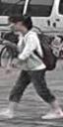
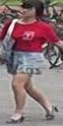
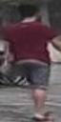
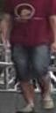
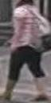
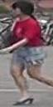
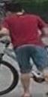
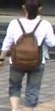

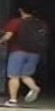
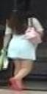


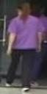
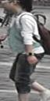

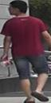
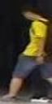

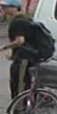

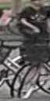
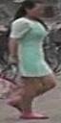
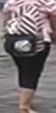


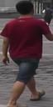
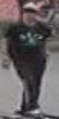
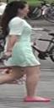
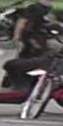


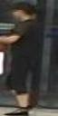
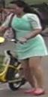
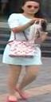
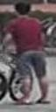



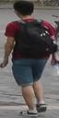
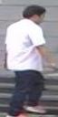

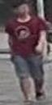

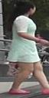


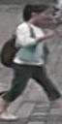
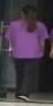
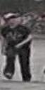


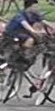
Challenge For Re-ID
rapid increase

Slide 10
Presentation Outline
Supervised Person Re-Identification
Unsupervised Person Re-Identification
Active Learning for Person Re-Identification
Occluded Person Person Re-Identification

Slide 11
Unsupervised Person Re-Identification
Training and testing data are from different domain
-> learned on the source domain and transfer the knowledge to target domain (unsupervised domain adaptation)
Train: Market1501
Test: DUKE

Slide 12
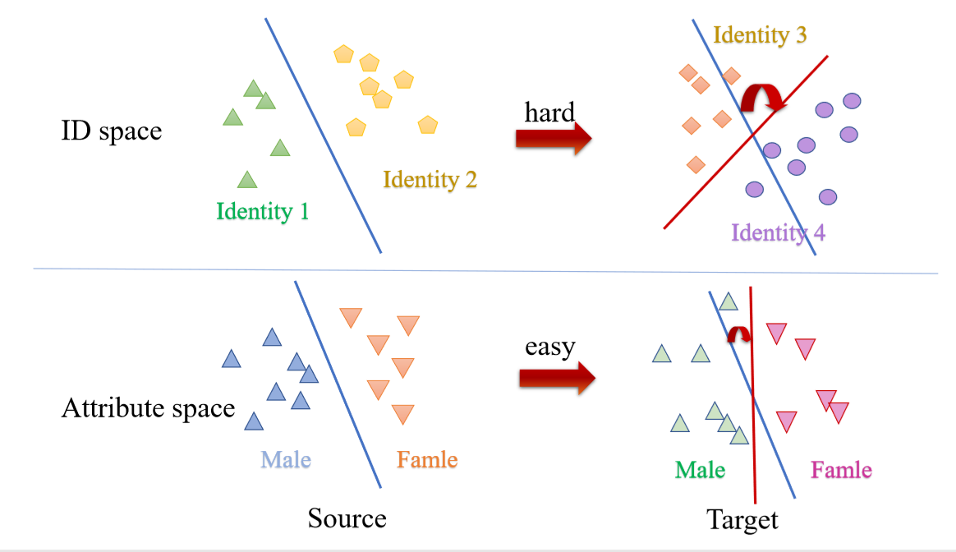
Unsupervised Person Re-Identification
Challenges:
Source and target domains have unknown camera viewing conditions
The identity/class between source and target domains are non-overlapping therefore presents a more challenging open-set recognition problem
-> Transferring knowledge of the source domain to target domain in attribute space

Slide 13
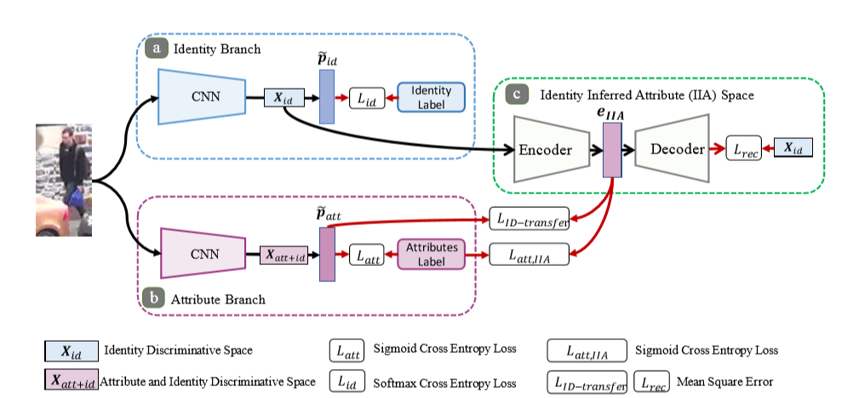
Unsupervised Person Re-Identification
Wang J, Zhu X, Gong S, Li W. Transferable joint attribute-identity deep learning for unsupervised person re-identification. CVPR,2018

Slide 14
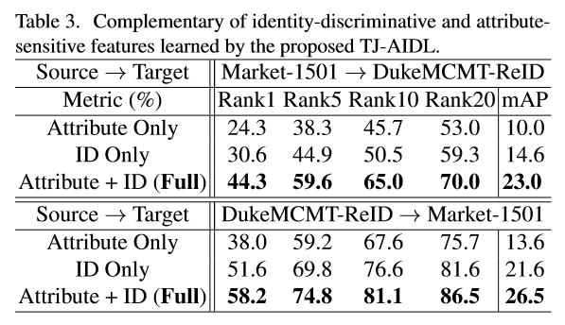
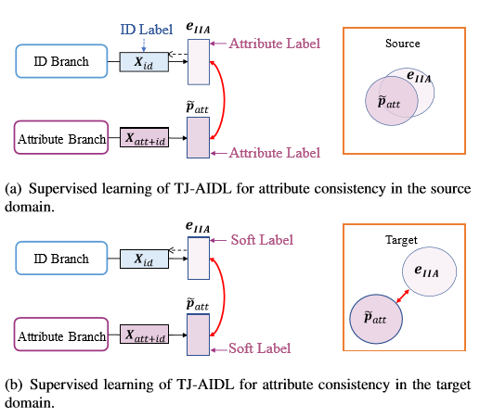
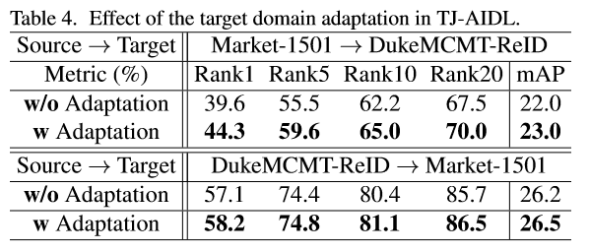
Unsupervised Person Re-Identification
Unsupervised Target Domain Adaptation

Slide 15
Unsupervised Person Re-Identification
Image-to-image translation method: SPGAN
preserved self-similarity and domain dissimilarity
Deng et al., Image-image domain adaptation with preserved self-similarity and domain-dissimilarity for person re-identification. CVPR 2018

Slide 16
Unsupervised Person Re-Identification
Image-to-image translation method: CamStyle GAN
Zhong, Zhun, et al. "Camera style adaptation for person re-identification." CVPR. 2018.

Slide 17
Challenge For Re-ID
rapid increase

Slide 18
Presentation Outline
Supervised Person Re-Identification
Unsupervised Person Re-Identification
Active Learning for Person Re-Identification
Occluded Person Person Re-Identification

Slide 19
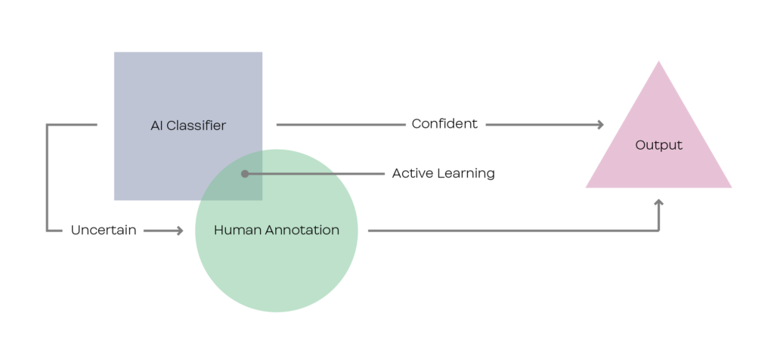
Make AI work in the real world: Human-In-The-Loop
Human-in-the-Loop (HITL) explores human feedback in an incremental learning cycle of the machine for rapid model domain adaptation
Notes:
That is why we intend to replace the traditional train-once-and-deploy strategy with the human-in-the-loop training style.
Human-in-the-loop includes human feedback into the training loop of the model to help it improve faster, and in return, the model contributes to optimize every step of the process.

Slide 20
Active learning is a special case of machine learning in which a learning algorithm is able to interactively query the user (or some other information source) to obtain the desired outputs at new data points.

Slide 21
There are three scenarios for Active learning :
1. Membership Query Synthesis: the learner generates/constructs an instance (from some underlying natural distribution).
2. Stream-Based selective sampling, i.e, each sample is considered separately in our case for label-querying or rejection. Similarly to online-learning, the data is not saved, there are no assumptions on data distribution, and therefore it is adaptive to change.

Slide 22
3. Pool-Based sampling, i.e., sampled are chosen from a pool of unlabeled data for the purpose of labeling

Slide 23
Active Learning Person Re-Identification
Training
Pool
selection strategy
request
label
model
query
Training
Pool
request
label
model
Agent
Liu, Z.*, Wang, J *., Gong, S., Lu, H. and Tao, D. Deep Reinforcement Active Learning for Human-in-the-Loop Person Re-Identification. ICCV, 2019,Oral

Slide 24






Concept
A user annotates few informative pedestrian pairs recommended by an adaptive agent in a human-in-the-loop learning mechanism
Re-ID Model
Sample Selection
(agent)
state
action
$$A_{t}$$
Agent
query anchor
unlabeled gallery pool
Pairwise Data
reward
query for label
annotator
human-in-the-loop
Goal: Sample Informative Pair
Action: Select One Sample at Each Step
State: Reflect Sample Correlation
Reward: Uncertainty
Notes:
For the proposed approach, we employ a similar structure which requires human to annotate few informative pedestrian pairs recommended via an adaptive sample selection strategy.
This strategy is implemented through an agent network, which aims to sample informative pairs with different inputs.
Therefore, the action function is to select one sample for label querying at each step, and the design of the state value should reflect the correlations among the query anchor and the gallery pool.
Here we represent the state by a sparse similarity score.
Like standard active learning approaches, we also use data uncertainty as the reward function, which is computed via the triplet distance.

Slide 25


Methodology
Joint Reinforcement Active Learning in A Deep Network
Re-ID Loss(Triplet)
query
0 | 0.83 | 0.71 | 0.66 | 0.47 | 0.36
0.83 | 0 | 0.85 | 0 | 0.87 | 0
0.71 | 0.85 | 0 | 0 | 0 | 0
0.66 | 0 | 0 | 0 | 0 | 0
0.47 | 0.87 | 0 | 0 | 0 | 0.77
0.36 | 0 | 0 | 0 | 0.77 | 0
q
CNN
$$ω$$
STATE
Agent
$$π$$
ACTION
gallery pool
annotator
…
q
g_{K}
g₁
g₂
g_{N}
REWARD
false
Sample Selection Strategy
Notes:
The methodology of the proposed approach is as shown,
as each query person and its corresponding gallery pool come, a deep network omega is employed to extract the features.
A sparse similarity map is computed via the features and taken as the initial value of the state function.
Later, the state is fed into the agent network pi, consisted by three full connected layers, and outputs an optimal pair to the human annotator.
To reduce the workload, we only require the annotator to provide a binary positive or negative feedback.
In one way, this feedback contributes to the revision of state value by strengthening the correlations of similar samples or weakening the un-similar ones.
In another way, the feedback is used to compute the reward value at the current action.
The agent stops the recommendation process based on a pre-defined maximal annotation number.
After several times, with enough pairwise data being collected, the re-identification model parameter can be fine-tuned with triplet loss function.

Slide 26
Methodology
1. Base CNN Network
2. A Deep Reinforced Active Learner - An Agent
Action: Select One Sample at Each Step
State: We construct a sparse similarity graph among query and gallery samples and take it as the state value (Reflect Sample Correlation)

Slide 27
An example of state updating with different human feedback
Reward: we perform a similar hard triplet loss to measure the uncertainty of data.
Notes:
future rewards(Rt+1, Rt+2, ...) discounted by a factor γ at time t can be calculated as
Once Q∗ is learned, the optimal policy π ∗ can be directly inferred by selecting the action with the maximum Q value

Slide 28
Dataset & Result (Market-1501)
87.95
84.2
73.25
66.26
42.79
20.04
Supervised
Ours
Transfer unsupervised
100% annotated
0.15% annotated
0% annotated
R-1
mAP
Notes:
QIU Query Instance Uncertainty ： strategy selects the samples with the highest uncertainty for querying
Query By Committee (QBC), is a very effective active learning approach which learns an ensemble of hypotheses， and queries the instances that cause maximum disagreement among the committee
Graph Density [12] (GD), constructs graph structure to identify highly connected nodes and determine the most representative data for querying

Slide 30
Presentation Outline
Supervised Person Re-Identification
Unsupervised Person Re-Identification
Active Learning for Person Re-Identification
Occluded Person Person Re-Identification

Slide 31
Occluded person re-identification aims to retrieve the person who was occluded by diversified obstacles
Main challenge
The diversified occlusions sometimes show more discriminative information, which would introduce interference to the feature of target person.
Gao, S., Wang, J ., Lu, H.and Liu, Z. Pose-guided Visible Part Matching for Occluded Person ReID . CVPR, 2020
Notes:
Occluded person re-identification aims to retrieve the person who was occluded by diversified obstacles
the main challenge of this task is the diversified occlusions

Slide 32
Motivation
Occluded regions should be excluded when comparing two persons
Region extraction and visibility estimation by heuristics may not be optimal and suffering a huge data bias
The relevance of a part-pair in a positive pair appears to be high only when both parts in two images are visible
Notes:
An intuitive solution is to detect the non-occluded body parts and then match each counterpart separately. Region extraction and visibility estimation by heuristics may not be optimal and suffering a huge data bias
An intuitive solution is to detect the non-occluded body parts and then match the correspondents separately. Region extraction and visibility estimation by heuristics may not be optimal and suffering a huge data bias

Slide 33
Contributions:
We propose a Pose-guided Visible Part Matching (PVPM) method that jointly learn the discriminative features with pose-guided attention and predict the part visibility in an end-to-end framework
We train the visibility prediction model under a self-supervised manner which generate the part correspondence by graph matching
Notes:
We propose a pvpm method that jointly learn the pose-guided attention and part visibility in an end-to-end framework
We propose a pvpm method that jointly learn the feature with pose-guided attention and part visibility in an end-to-end framework
And We train the visibility predictor under a self-supervised manner

Slide 34

Architecture of PVPM
Obtaining pose feature
Predicting part visibility score with PVP
Generating part attention maps with PGA
Calculating distance
Extracting global appearance feature
Extracting part appearance feature by part pooling
Notes:
PVPM generate part attention maps and visibility with PGA and PVP module.
And then weight the part distance with visibility score when calculating overall distance
PVPM generate part attention maps and part visibility score with PGA and PVP module. And then weight the part distance with visibility score when calculating overall distance

Slide 35
Methodology
Generating
Pseudo-label
Notes:
A key challenge is how to train the visibility predictor.
we explore the part correspondence
and self-mine visibility score via graph matching
Graph matching was introduced
for pseudo label generation and optimize visibility predictor without data bias.

Slide 36




Methodology
Representing a positive pair as two graphs:
Constructing the affinity matrix M:
Generating pseudo-label via graph matching:
Notes:
and self-mine visibility score via graph matching
We treat a positive pair as two graphs and generating pseudo-label via graph matching

Slide 37
Methodology
Notes:
Three loss functions are employed to optimize the proposed method

Slide 38


Experiments
Notes:
Finally, PVPM achieves superior performance on multiple occlusion datasets

Slide 39
Presentation Outline
Link Person Re-Identification with ….
Attribute Learning
Detection (Person Search )
Tracking (Multi-target multi-camera tracking)

Slide 40



Person Re-Identification and Attribute Learning
How do human brain match person?
Long hair
bag
Attribute recognition usually denotes local structures of a person

Slide 41

Attribute Recognition in in Surveillance
Challenges:
Poor image quality
Complex background clutter
Uncontrolled viewing conditions
Small number of labelled training

Slide 42

Attribute Recognition in in Surveillance
Main idea:
Discover the interdependency and correlation among attributes
Explore visual context as an extra information source to assist attribute recognition
Contributions:
A novel end-to-end encoder-decoder architecture capable of jointly learning image level context and attribute level sequential correlation
Exploit more latent and richer higher-order dependency among attributes
Wang, J, et al. "Attribute recognition by joint recurrent learning of context and correlation." ICCV. 2017

Slide 43
Person Re-Identification and Attribute Recognition
Lin, Yutian, et al. "Improving person re-identification by attribute and identity learning." Pattern Recognition (2019).

Slide 44
Attribute-based Person Re-Identification

Slide 45
Attribute-based Person Re-Identification
Yin, Zhou, et al. "Adversarial attribute-image person re-identification." IJCAI, 2018.

Slide 46
Presentation Outline
Link Person Re-Identification with ….
Attribute Learning
Detection (Person Search )
Tracking (Multi-target multi-camera tracking)

Slide 47
Person Re-Identification and Detection
Zheng, L., Yang, Y., & Hauptmann, A. G. (2016). Person re-identification: Past, present and future.

Slide 48
Person Re-Identification Datasets

Slide 49
Person Re-Identification and Detection
Detection
Xiao, Tong, et al. "Joint detection and identification feature learning for person search." CVPR. 2017

Slide 50
Person Re-Identification and Detection
Liu, Hao, et al. "Neural person search machines." ICCV. 2017.

Slide 51
Presentation Outline
Link Person Re-Identification with ….
Attribute Learning
Detection (Person Search )
Tracking (Multi-target multi-camera tracking)

Slide 52
Multi-target multi-camera tracking
1st MTMCT and ReID workshop CVPR 2017
2nd MTMCT and ReID workshop CVPR 2019
Duke MTMC (Multi-Target, Multi-Camera) dataset

Slide 53
Multi-target multi-camera tracking
Ristani, Ergys, and Carlo Tomasi. "Features for multi-target multi-camera tracking and re-identification." CVPR. 2018.

Slide 54
Conclusion
Supervised Person Re-Identification
Unsupervised Person Re-Identification
Active Learning for Person Re-Identification
Occluded Person Person Re-Identification
Link Person Re-Identification with ….
Attribute Learning
Detection (Person Search )
Tracking (Multi-target multi-camera tracking)

Slide 55
Thank you

